Slide 1

POSCAT Seminar 5 : Recursion and Divide & Conquer
yougatup @ POSCAT

Slide 2
Topic
Topic today
Recursion
Basic Concept
Divide & Conquer
Basic Concept
Finding Medians
Closest Pair
Implementation
By the way, do you solve all the problems ?

Slide 3
You should already know what recursion is !

Slide 4
Divide & Conquer
Problem Solving Paradigm
1. Break the problem into subproblems : smaller instances
Solve them recursively
Combine the solutions to get the answer to the problem.
Calculation of time complexity is not trivial
We need Master theorem to calculate it
Recurrence relation
Not that important now

Slide 5
Finding Medians and Selection
Problem
Find the k-th smallest element in S, where S is a set of numbers

Slide 6

Finding Medians and Selection
Problem
Find the k-th smallest element in S, where S is a set of numbers
Naïve approach : Sort it ! O($n\log{n}$)

Slide 7
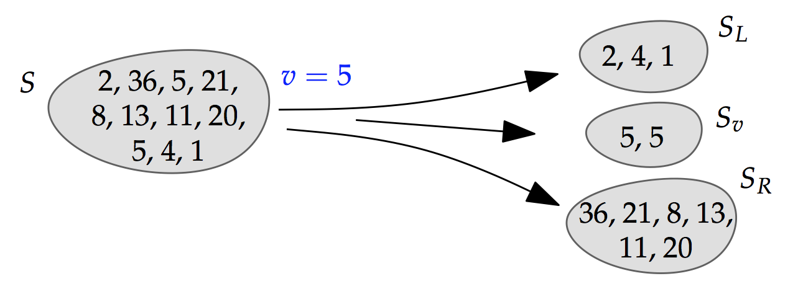

Finding Medians and Selection
Problem
Find the k-th smallest element in S, where S is a set of numbers
Naïve approach : Sort it ! O($n\log{n}$)
Divide & Conquer : Choose $v$ and split S into $S_{L}$, $S_{v}$, $S_{R}$ !

Slide 8
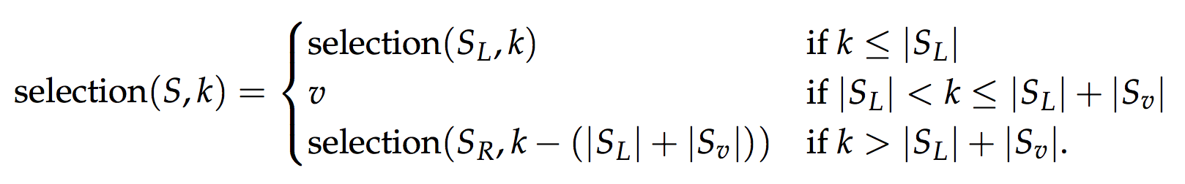
Finding Medians and Selection
Problem
Find the k-th smallest element in S, where S is a set of numbers
Naïve approach : Sort it ! O($n\log{n}$)
Divide & Conquer : Choose $v$ and split S into $S_{L}$, $S_{v}$, $S_{R}$ !

Slide 9
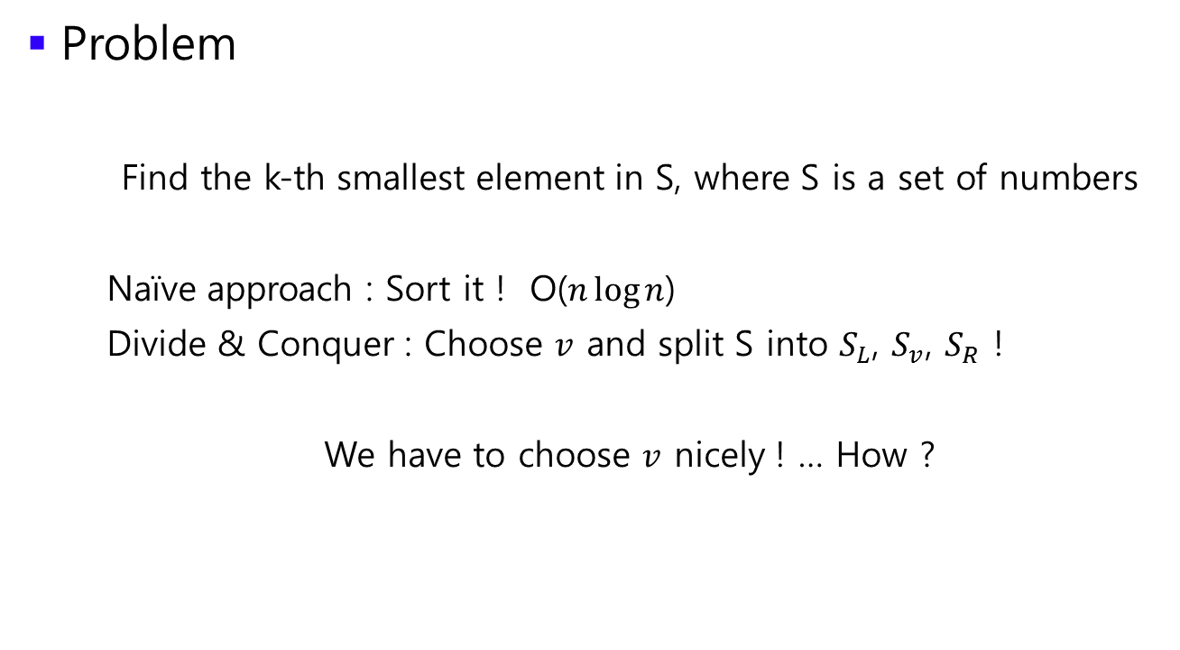
Finding Medians and Selection
Problem
Find the k-th smallest element in S, where S is a set of numbers
Naïve approach : Sort it ! O($n\log{n}$)
Divide & Conquer : Choose $v$ and split S into $S_{L}$, $S_{v}$, $S_{R}$ !
We have to choose $v$ nicely ! … How ?

Slide 10
Finding Medians and Selection
Problem
Find the k-th smallest element in S, where S is a set of numbers
Naïve approach : Sort it ! O($n\log{n}$)
Divide & Conquer : Choose $v$ and split S into $S_{L}$, $S_{v}$, $S_{R}$ !
We have to choose $v$ nicely ! … How ?
Randomly !

Slide 11

Finding Medians and Selection
Problem
If we’re lucky, then the partition goes to small very fast. If not, It will take O($n^{2}$). Can we trust random choice of $v$ ?

Slide 12

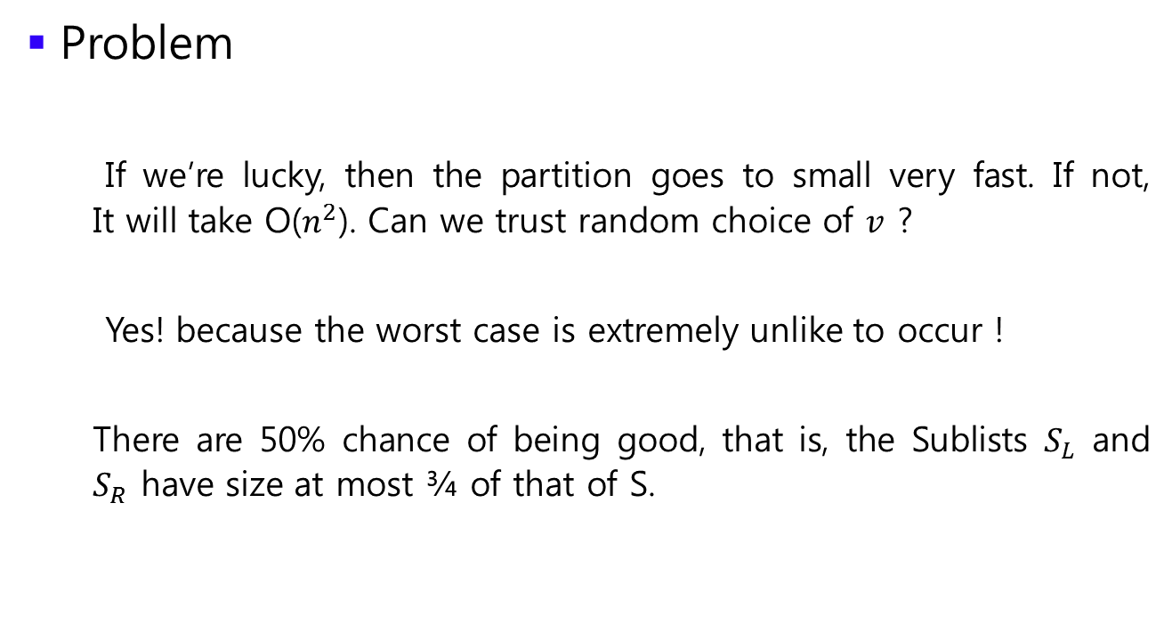
Finding Medians and Selection
Problem
If we’re lucky, then the partition goes to small very fast. If not, It will take O($n^{2}$). Can we trust random choice of $v$ ?
Yes! because the worst case is extremely unlike to occur !
There are 50% chance of being good, that is, the Sublists $S_{L}$ and $S_{R}$ have size at most ¾ of that of S.

Slide 13
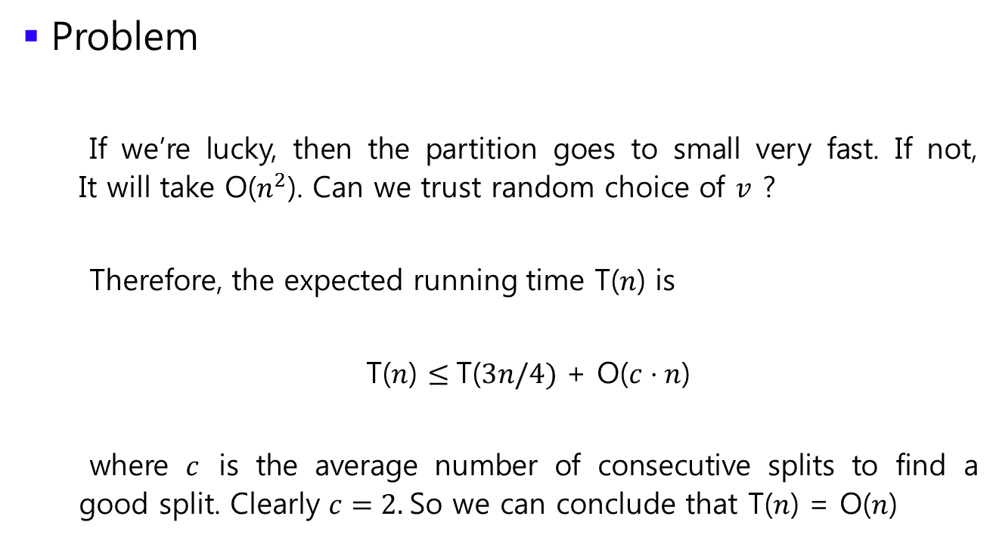
Finding Medians and Selection
Problem
If we’re lucky, then the partition goes to small very fast. If not, It will take O($n^{2}$). Can we trust random choice of $v$ ?
Therefore, the expected running time T($n$) is
T($n$) $≤$T($3n/4)$ + O($c⋅n$)
where $c$ is the average number of consecutive splits to find a good split. Clearly $c=2.$So we can conclude that T($n$) = O($n$)

Slide 14

Closest pair of points
Problem
Given $n$ points in the plane, find a pair with smallest Euclidean distance between them.

Slide 15

Closest pair of points
Problem
Given $n$ points in the plane, find a pair with smallest Euclidean distance between them.
Brute force approach : Check all pairs of points. O($n^{2}$)

Slide 16
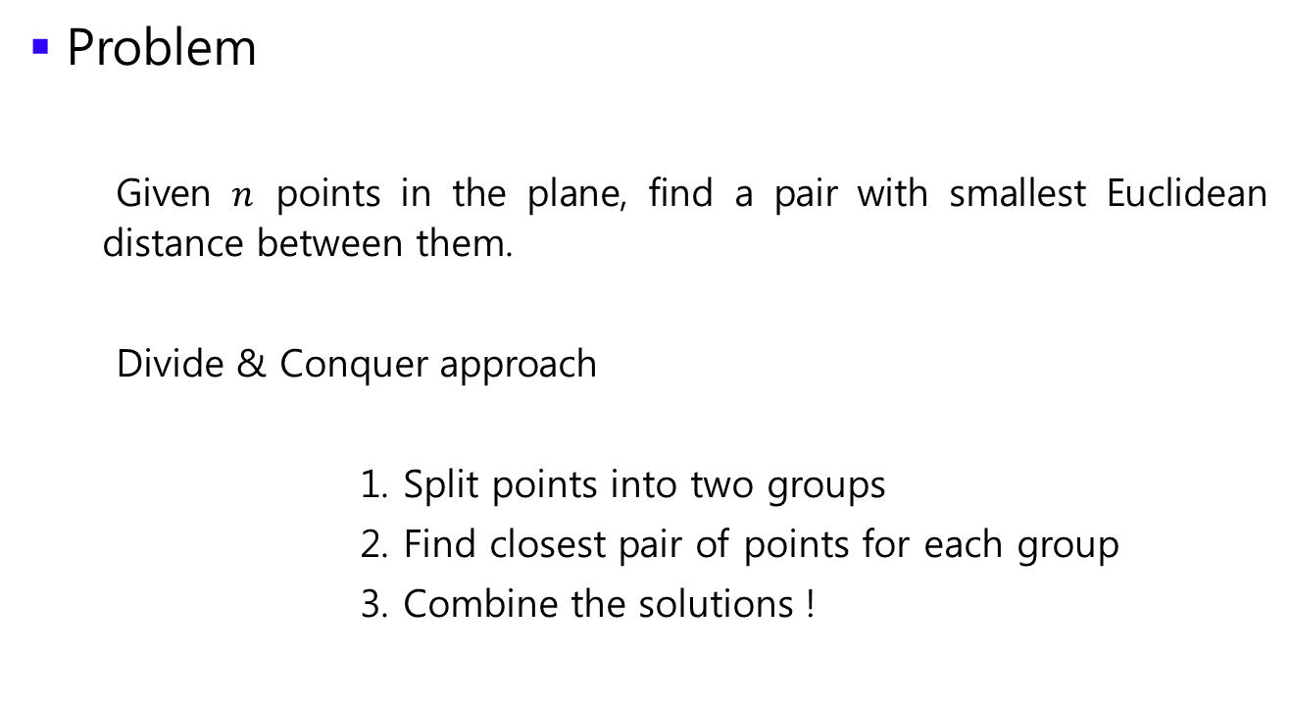
Closest pair of points
Problem
Given $n$ points in the plane, find a pair with smallest Euclidean distance between them.
Divide & Conquer approach
Split points into two groups
Find closest pair of points for each group
Combine the solutions !

Slide 17

Closest pair of points
Problem
Given $n$ points in the plane, find a pair with smallest Euclidean distance between them.
1. Split points into two group

Slide 18
Closest pair of points
Problem
Given $n$ points in the plane, find a pair with smallest Euclidean distance between them.
1. Split points into two group

Slide 19

Closest pair of points
Problem
Given $n$ points in the plane, find a pair with smallest Euclidean distance between them.
2. Find closest pair of points for each group

Slide 20

Closest pair of points
Problem
Given $n$ points in the plane, find a pair with smallest Euclidean distance between them.
3. Combine the solutions ?

Slide 21
Closest pair of points
Problem
Given $n$ points in the plane, find a pair with smallest Euclidean distance between them.
3. Combine the solutions ?
Is it enough to choose small one between two solutions ?

Slide 22
Closest pair of points
Problem
Given $n$ points in the plane, find a pair with smallest Euclidean distance between them.
3. Combine the solutions ?
Is it enough to choose small one between two solutions ?
We didn’t consider it

Slide 23
Closest pair of points
Problem
Given $n$ points in the plane, find a pair with smallest Euclidean distance between them.
3. Combine the solutions ?
Then, do we have to consider all the cases when a pair consists of a point in the left and a point in the right ?

Slide 24
Closest pair of points
Problem
Given $n$ points in the plane, find a pair with smallest Euclidean distance between them.
3. Combine the solutions ?
Then, do we have to consider all the cases when a pair consists of a point in the left and a point in the right ? No! because we have partial solution !

Slide 25




Closest pair of points
Problem
Given $n$ points in the plane, find a pair with smallest Euclidean distance between them.
Idea : If a closer pair is exist, then it must be in the grey region
$$δ$$
$$δ$$
$$δ$$

Slide 26
Closest pair of points
Problem
Given $n$ points in the plane, find a pair with smallest Euclidean distance between them.
Idea : If a closer pair is exist, then it must be in the grey region
$$δ$$
$$δ$$
Still, worst case can happen
$$δ$$

Slide 27
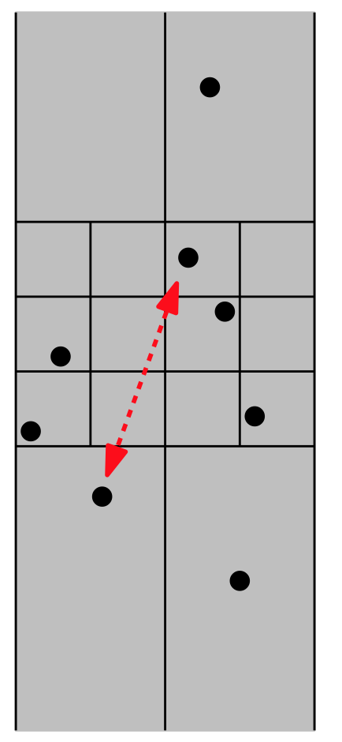
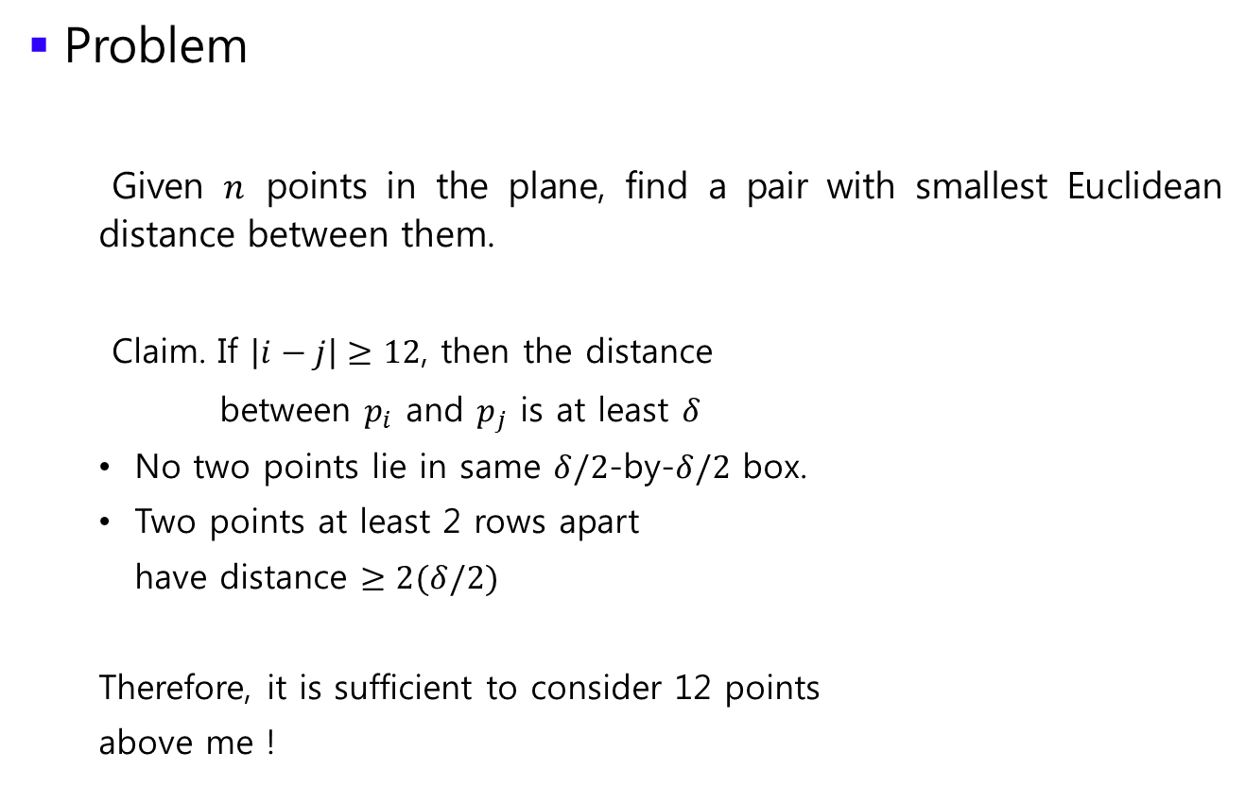
Closest pair of points
Problem
Given $n$ points in the plane, find a pair with smallest Euclidean distance between them.
Claim. If $\left|i−j\right|≥12$, then the distance
between $p_{i}$ and $p_{j}$ is at least $δ$
No two points lie in same $δ/2$-by-$δ/2$ box.
Two points at least 2 rows apart
have distance $≥2(δ/2)$
Therefore, it is sufficient to consider 12 points
above me !

Slide 28
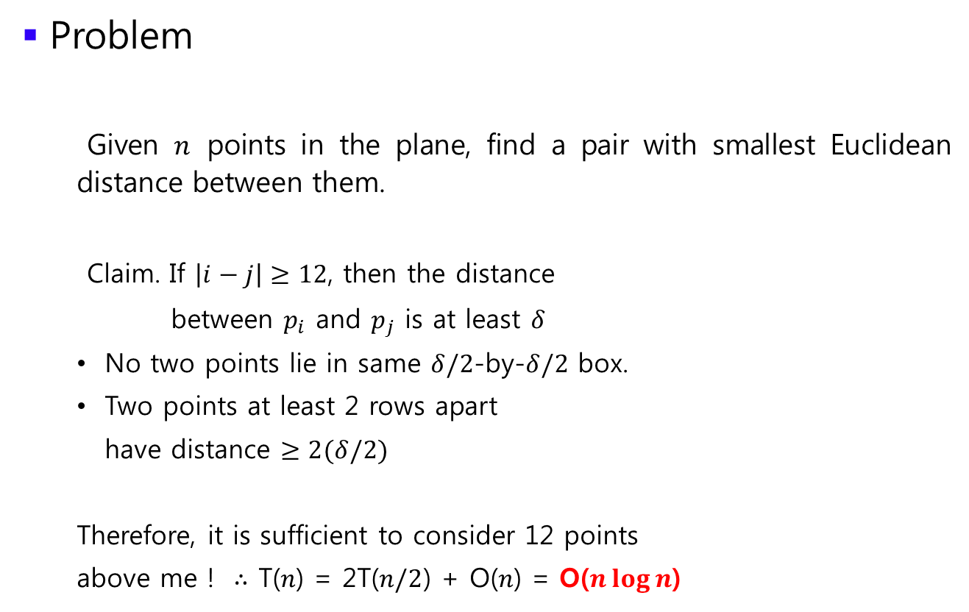
Closest pair of points
Problem
Given $n$ points in the plane, find a pair with smallest Euclidean distance between them.
Claim. If $\left|i−j\right|≥12$, then the distance
between $p_{i}$ and $p_{j}$ is at least $δ$
No two points lie in same $δ/2$-by-$δ/2$ box.
Two points at least 2 rows apart
have distance $≥2(δ/2)$
Therefore, it is sufficient to consider 12 points
above me ! $∴$ T($n$) = 2T($n/2$) + O($n$) = O($n\log{n}$)

